Slide 1




Business use case – SZW*IIMB TEAM: Dipjyoti, Bharathi, Moitreyee, Rajesh
Data is fragmented over zoho systems
Problem STATEMENT - Unification of data for :
1. Vendor selection engine
Based on historical data on Quantitative KPIs (Rate per kg/ Quantity/ Total Amount/ Material Type) and Qualitative KPIs (Debit Notes - Quality/ Location/ Compliance factors)
2. Price benchmarking
Based on historical data a monthly forecast of the trend of prices and rate per kg – on which new vendors can be onboarded

Slide 2

DATA Source identification & understanding
Data Sources
Highly fragmented data on
ZOHO Books
ZOHO VMS
ZOHO CRM
Manual entries
Data Inconsistency
Missing Values – on Data and as well as on KPI data
Structural Errors – like case sensitivity issues, special/random characters
Outliers – like negative values on Amount and Quantity
Empty Vendor Names – wrongly entered data
Duplicate Records
Irrelevant Item Names

Slide 3

CHALLENGES FACED
Quality Issues Identified
Invoices Details contained various items, rate per kg, total amount all together
Non-uniform entries in invoices
Items relevant to respective Business Verticals – Nomenclature issues
Undefined Categories/ Product codes – manually created lookup table to map
No Common Key on Qualitative KPIs
The Common Key is different in Vendors Data and the Quality KPI data (WIP to understand and identify how to stitch this data for qualitative analysis)
Location not available for 200-300 vendors
Debit note not properly maintained
Conditional Imputation for Compliance
GSTIN not applicable to all vendors
Validated/registered Vendor Status – Compliant

Slide 4
DATA CLEANING
Cleaning & Imputation
Data received from ZOHO Books VMS – 2019_2025
Data transformation steps:
Load and check on null values
Vendor Data Handling for null values
Invoice Status Handling – Conditional Imputation on Categorical values
Business Vertical Standardization
Item Details transformation – multiple items on one invoice
Items reclassification into categories and business verticals using lookup tables
Rate Imputation using Hierarchical Median
Quantity imputation using grouping and median
Total Amount Imputation
GST value considerations for relevant items
Deduplicating data if any
Data Understanding for Rate and Total Amount = 0 for certain invoices/items
Suggestion to Saahas Zero Waste
Proper DATA MANAGEMENT SYSTEM in future for Analysis

Slide 5
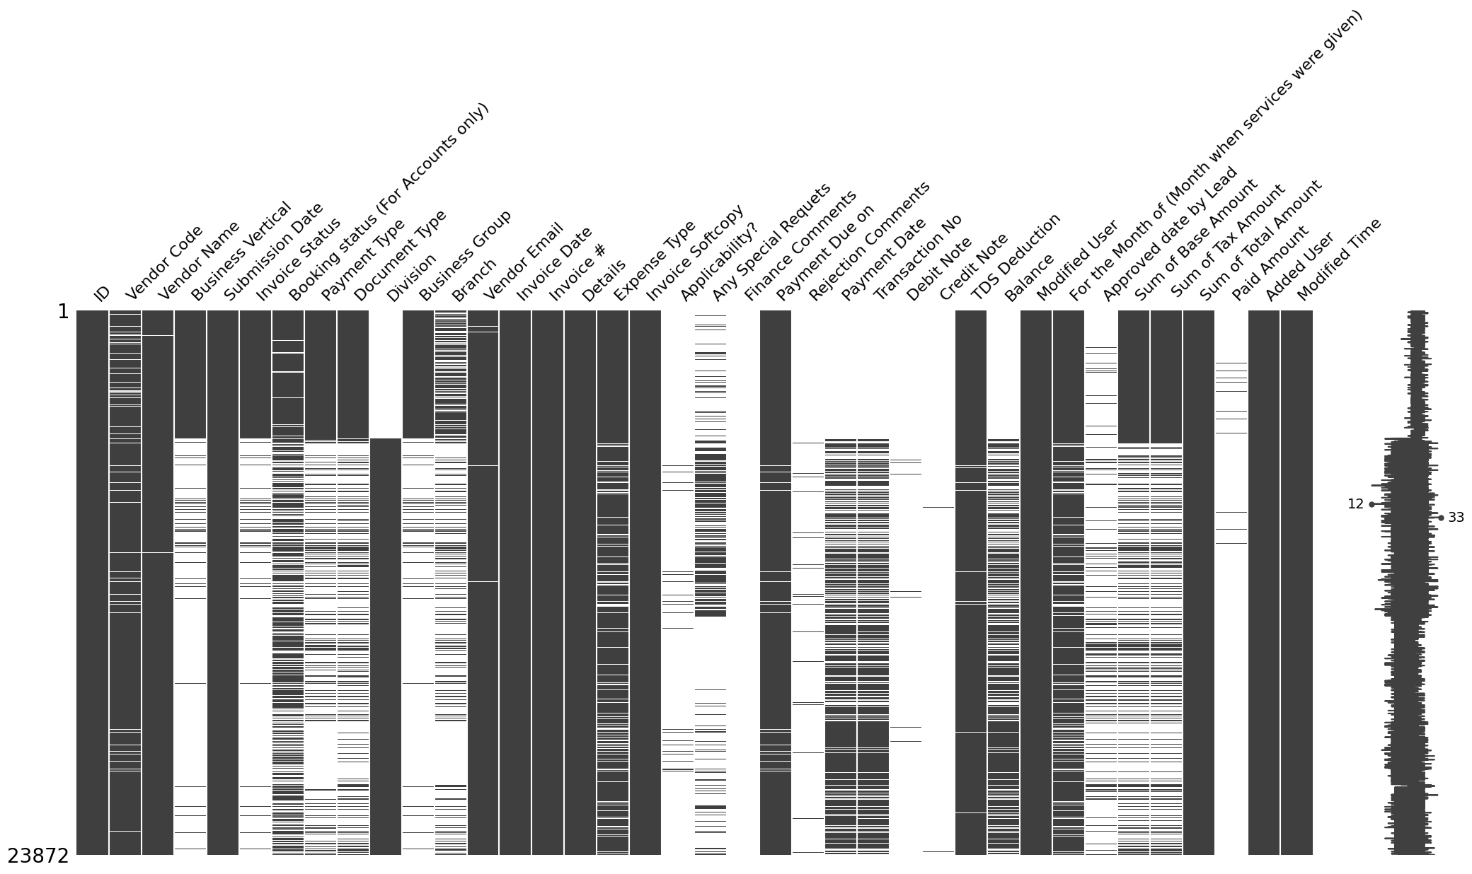
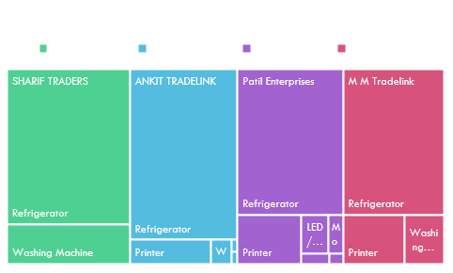
EWASTE Understanding

Slide 6
EDA FOR 4 major business verticals

Slide 7
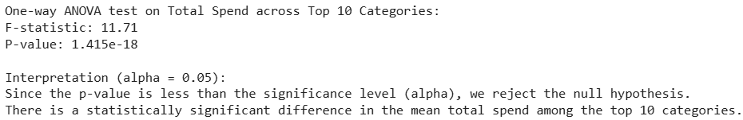
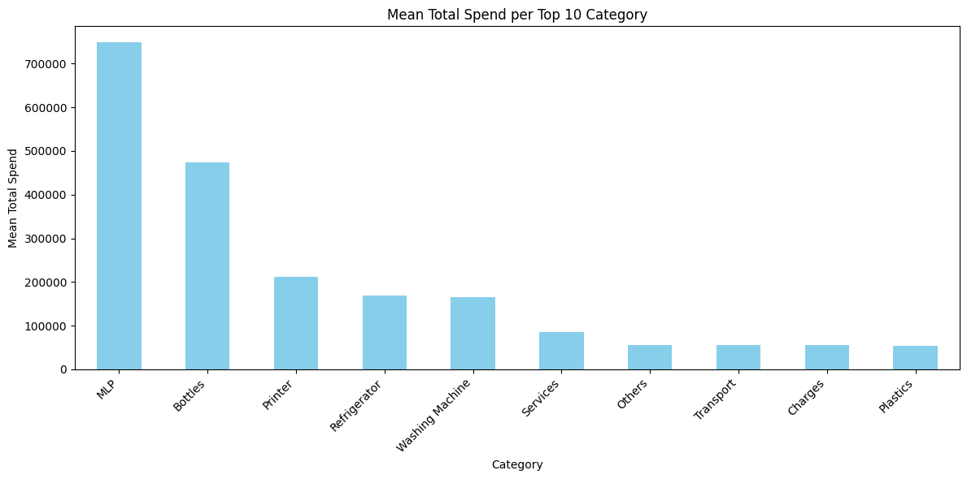
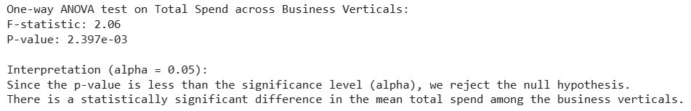
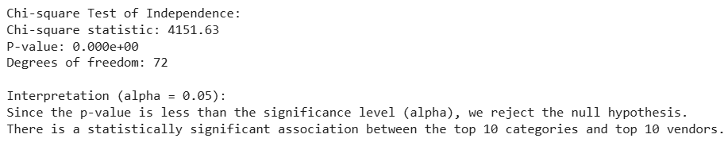
Hypothesis testing
Clustering approach – recommendation of vendors by segmentation
High volume, High Value
High volume, Low Value
Low Volume, High Value
Low Volume, Low Value - Discard

